Slide 1

Big query project_0
bRanjithsainaik

Slide 2



Agenda
ERR diagram
Solving query
Average scores across subjects of students grouped by year group.
Average scores across subjects of students grouped by gender
How does parental level of education affect student test scores?
How well did the test preparation course help students?
Sloving Qeries in gcp(big Query)
Data Visualization and Summary:

Slide 3


Introduction
we aim to equip you with a foundational understanding of ER diagrams, SQL basics, and data visualization techniques, empowering you to leverage these tools effectively in your data analysis endeavors

Slide 4
Data description:
Gender :
This dataset contains information categorized by gender (male and female)
Year Group:
This dataset categorizes data by different year groups or cohorts.
Parental,test,lunch,Level of Education :
This dataset categorizes data based on the educational attainment level of students' parents or guardians.
Math, Reading, Writing :
This dataset contains scores different subject scores
Student_id;

Slide 5
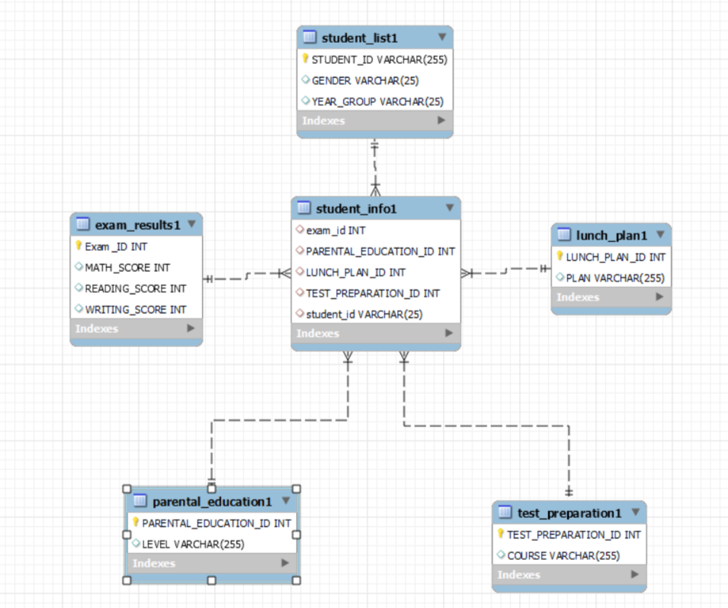
Entity-Relationship Diagram(ERD):
An ER diagram, short for Entity-Relationship diagram, serves as a visual representation of the relationships between different entities in a database.
It provides a clear and concise overview of how entities interact with each other within a system or database.

Slide 6
Summary

Slide 7





Thank you
Branjithsainaik | branjithsainaik033@gmail.com|ranjiithsainaik123

